Slide 2
Dr. Margaret Weber
Dean, Graduate School of Education and Psychology

Slide 3
To encourage and support women in pursuing their goals for family and/or career through informed decision making.

Slide 5
Personal success means – HBR, 2014

Slide 6
Professional success means – HBR, 2014

Slide 7
Working Moms
Half want to stay home but need extra income
Feel guilty
Partners: you don’t spend enough time with children
Stay at Home Moms
Half want to work but can’t afford childcare
Feel guilty
Partners: You don’t pull your weight

Slide 8
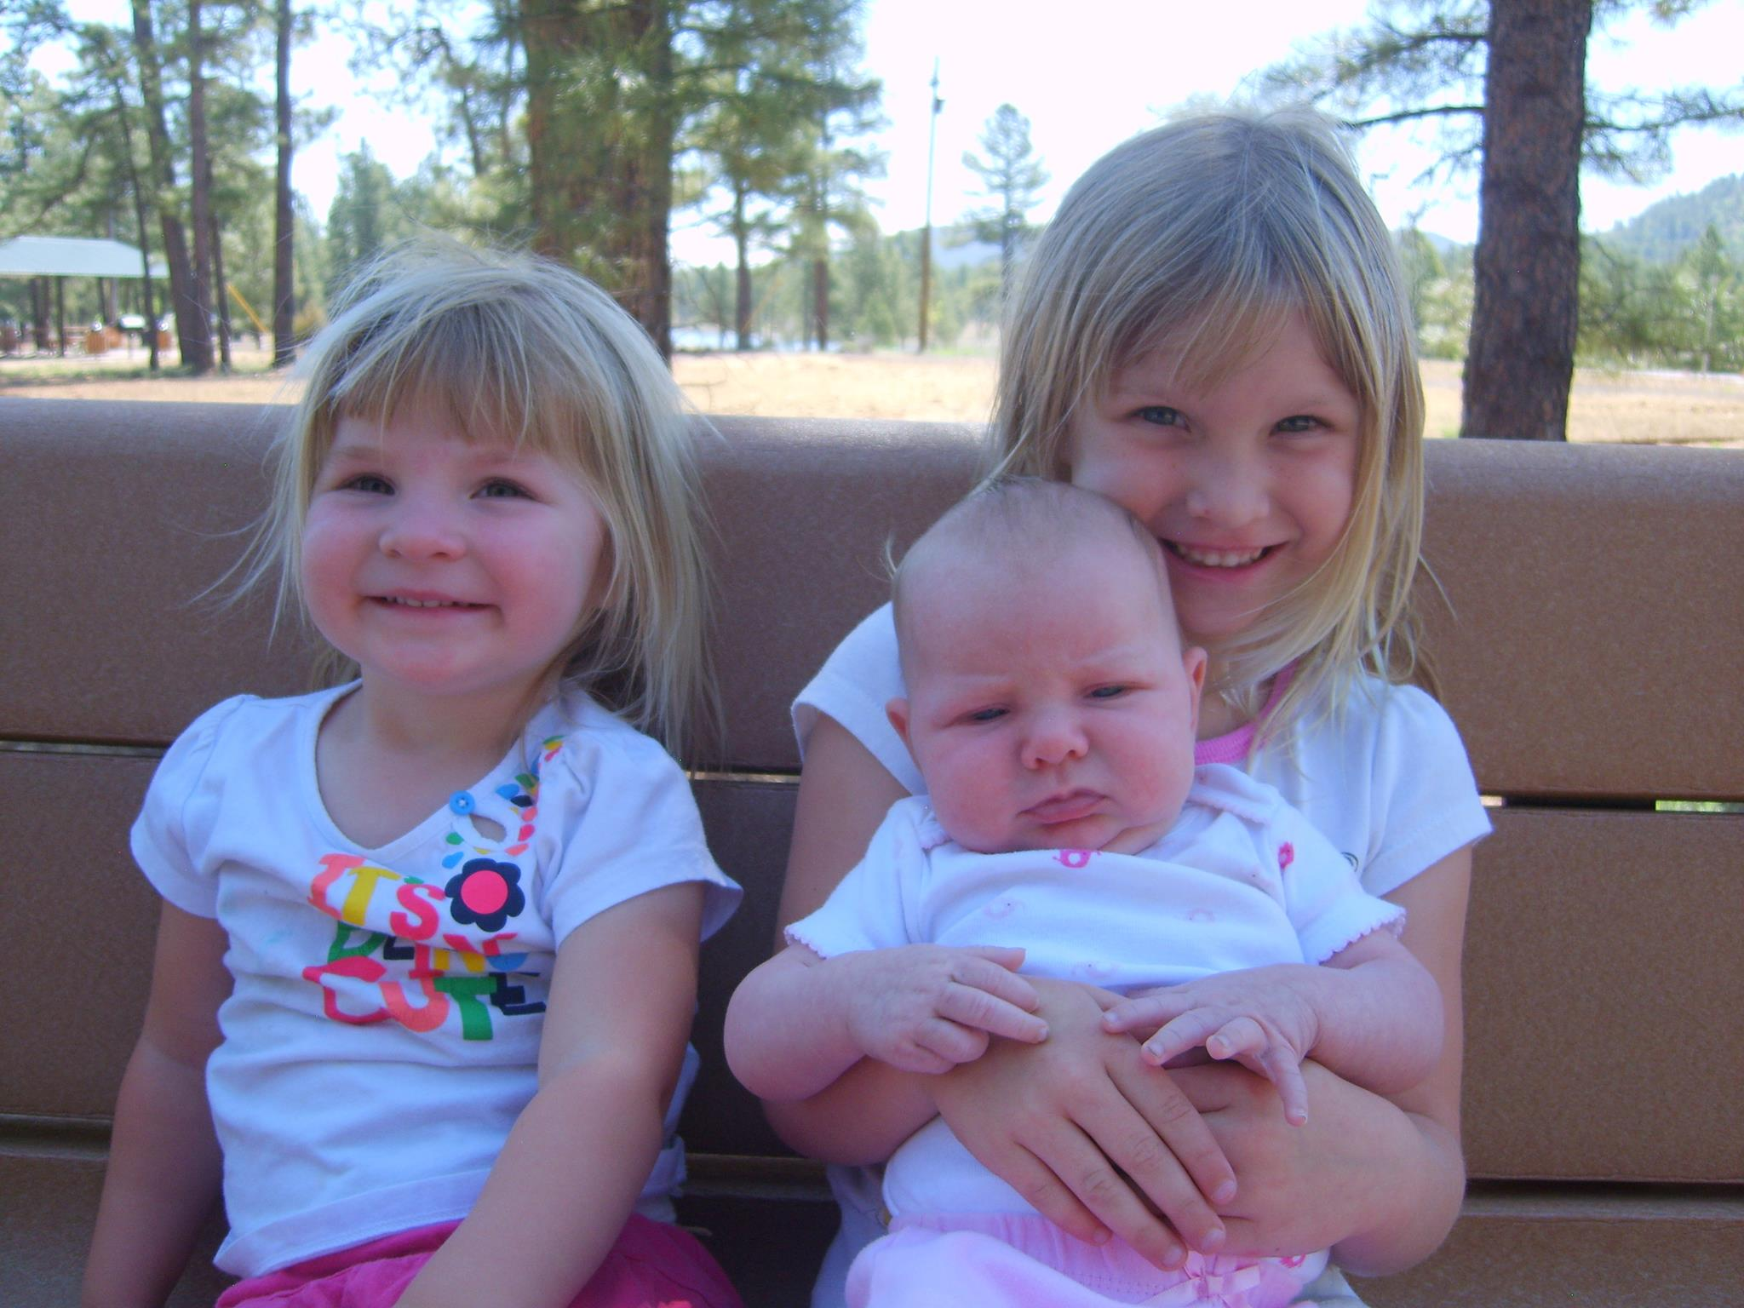
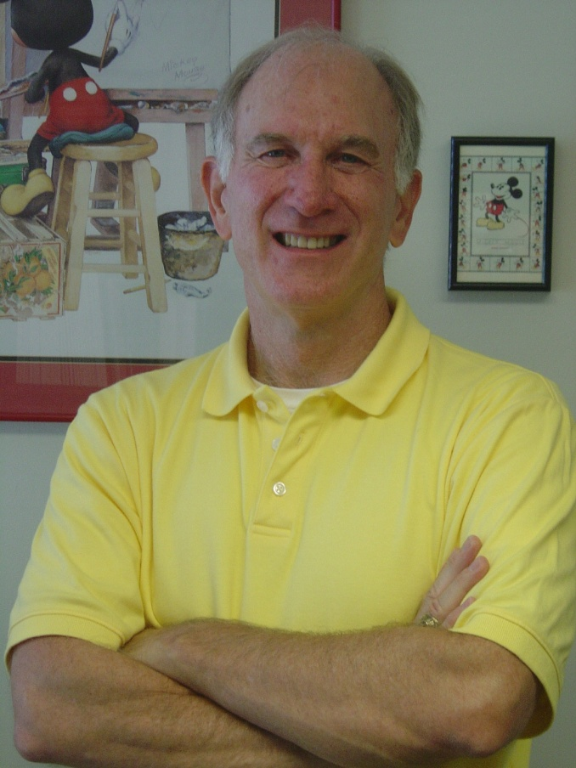

Slide 9
